Slide 1

Time Series Modeling for Natural Disasters in the United States
By: Rachel Beery

Slide 2
Problem Statement
Our client FEMA has tasked us with finding out how many natural disasters will happen in the coming three years and how to more properly prepare for these natural disasters

Slide 3
Data
This OpenFEMA dataset lists all official FEMA Disaster Declarations, beginning with the first disaster declaration in 1953 and features all three disaster declaration types: major disaster, emergency, and fire management assistance. The dataset includes declared recovery programs and geographic areas.
Our Time Series modeling begins in 1970 and focuses solely on the top three natural disasters: Severe Storms, Hurricanes, and Floods

Slide 4
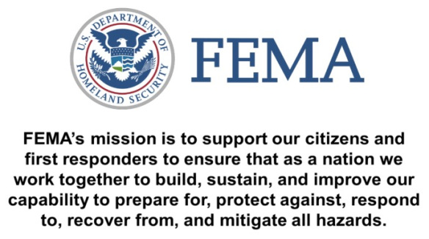

Slide 5
Methodology:
Time Series Models

Slide 6
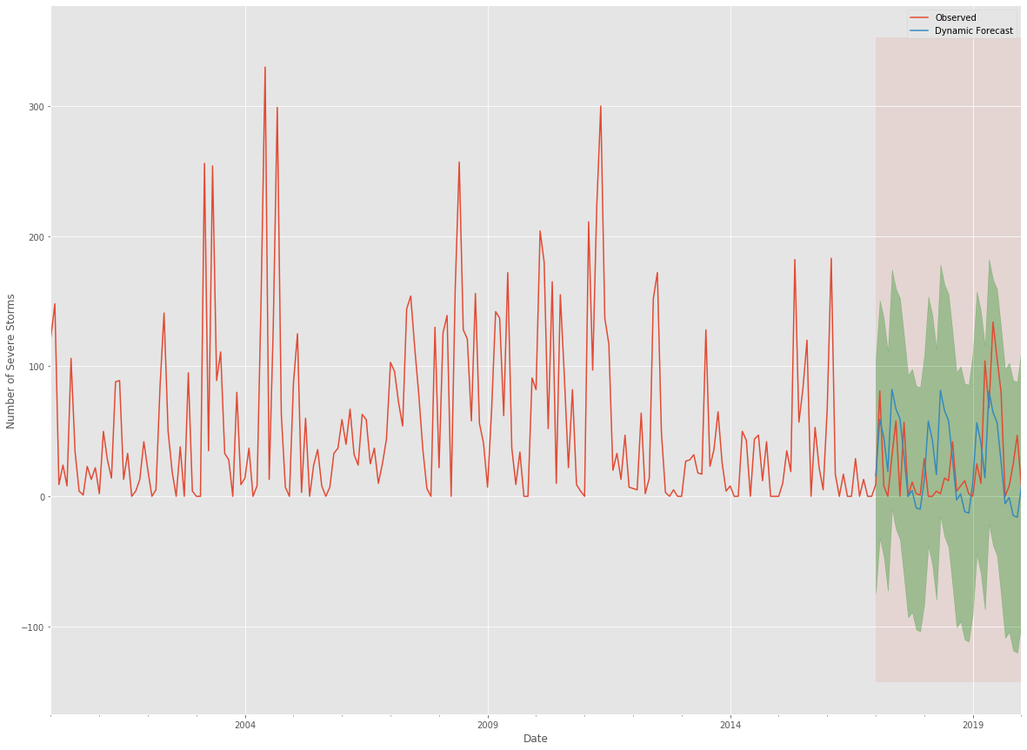

Slide 7
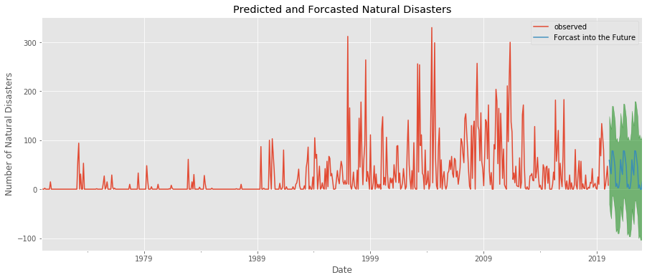
Time Series Model: Severe Storms

Slide 8
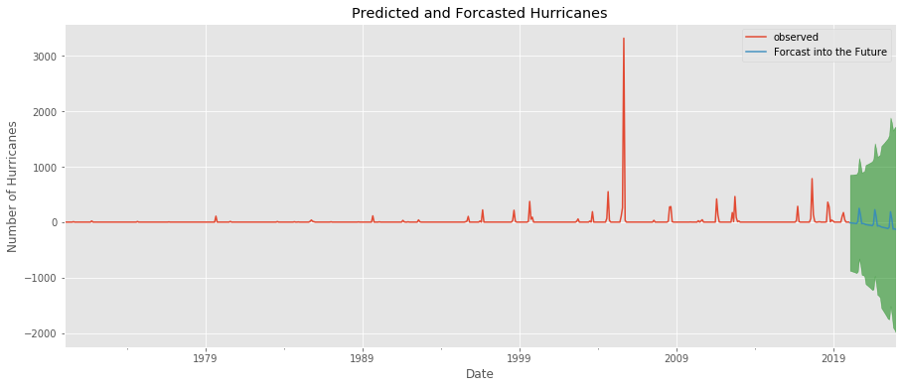
Time Series Model: Hurricanes

Slide 9
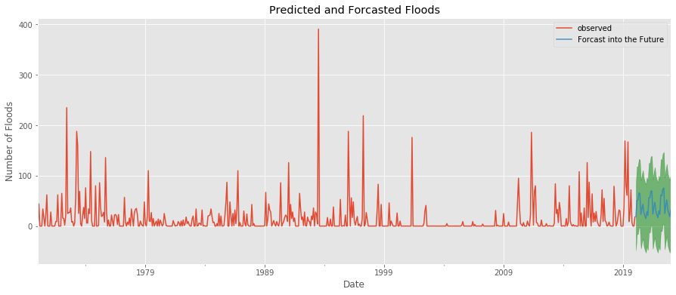
Time Series Model: Floods

Slide 10
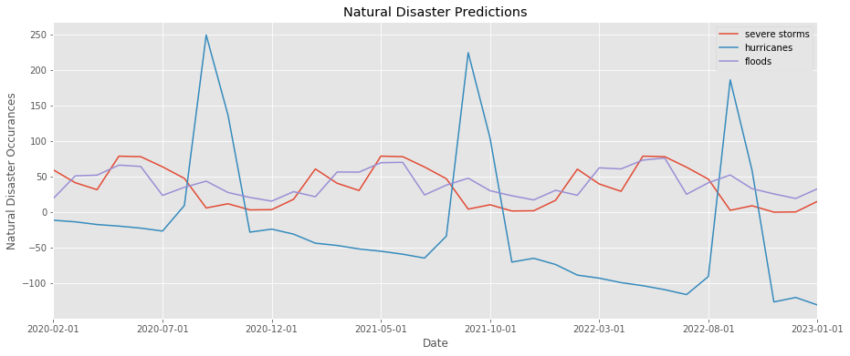

Slide 11
Recommendations
Severe Storms
FEMA should prepare communities for severe storms at highest risk before May in following years
Hurricanes
FEMA should prepare communities for severe storms at highest risk in August to October
Floods
FEMA should prepare communities from March to June for increased flooding occurrence and damages

Slide 12
Future Work
Research areas within the U.S. that have the most natural disasters
Biological Natural Disasters
COVID-19 & other possible pandemics
Snow, Fire, & Ice
Funding allocation
Community Preparation

Slide 13
Thank you!
Data provided by FEMA at the following website:
https://www.fema.gov/openfema-data-page/disaster-declarations-summaries-v2

Slide 14
Appendix

Slide 15
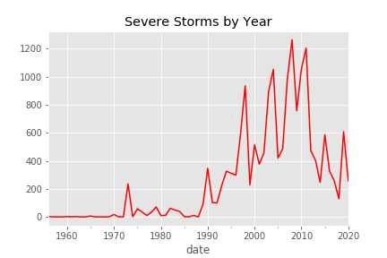

Slide 16
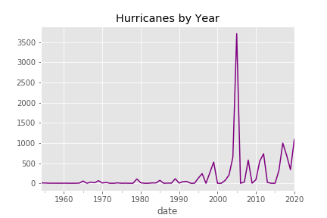

Slide 17
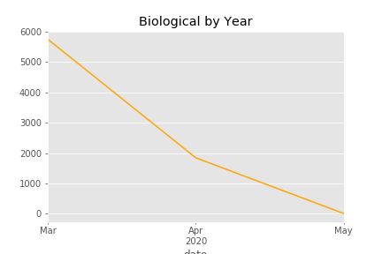

Slide 18
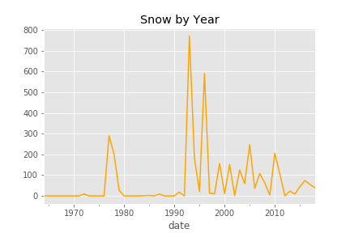

Slide 19
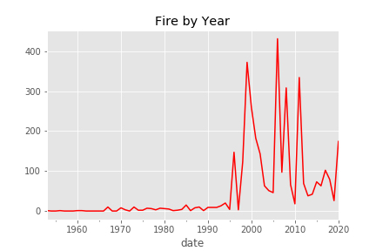

Slide 20
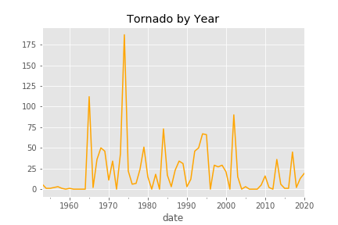

Slide 21
